Slide 1


Password Hashing and Graph Pebbling
Jeremiah Blocki
Samson Zhou

Slide 2
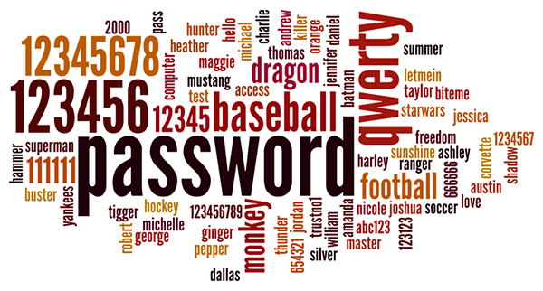

Motivation
Users tend to pick weak passwords
Server attacks are inevitable

Slide 3
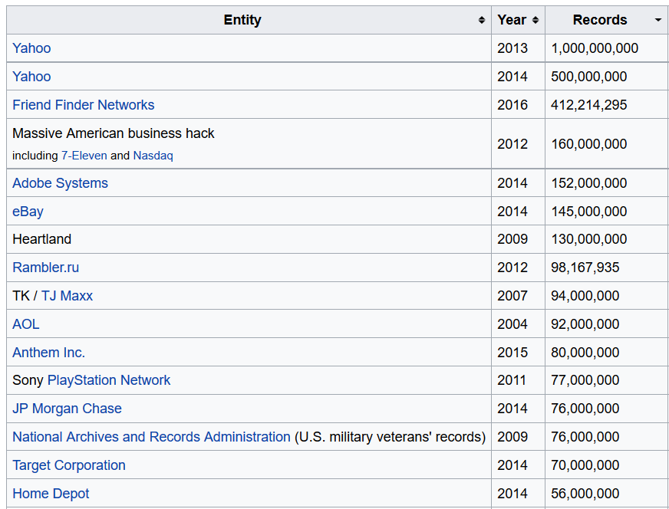

Slide 4















Slide 5
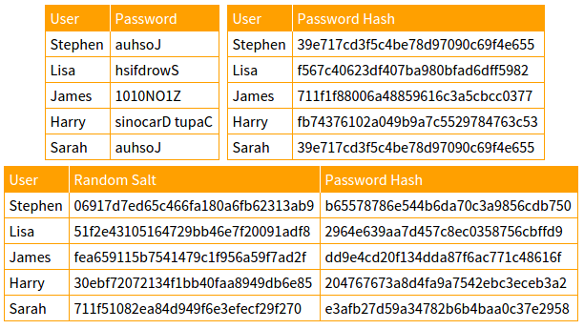

Slide 6
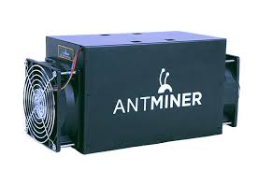

Motivation
Users tend to pick weak passwords
Server attacks are inevitable
Try to mitigate offline attacks
Specialized hardware (ASIC) can compute ${10}^{12}$ hashes per second.

Slide 7

Password Hash Function Goals
“Moderately Expensive” to compute
Expensive to compute on ASIC
Fast and cheap on PC

Slide 8
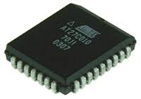



Slide 9
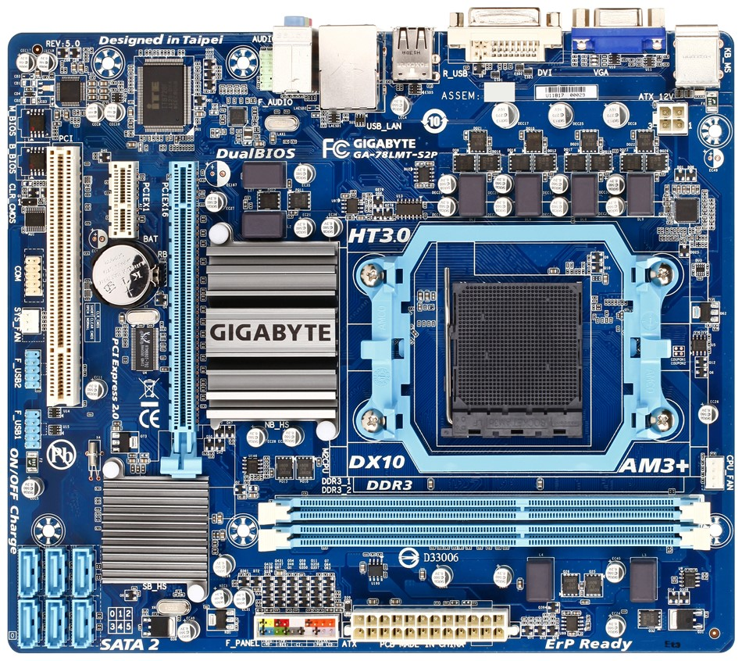
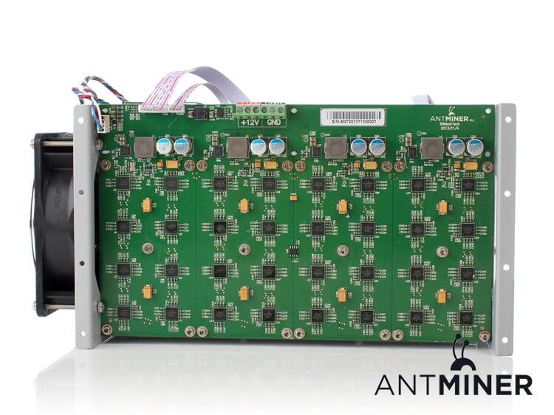

Slide 10
Memory Hard Functions
Memory hard functions require comparatively more resources for adversaries to compute
Data-dependent memory hard functions are susceptible to side-channel attacks
Data-independent memory hard functions (iMHFs)

Slide 11

iMHFs
$$f_{G,H}$$
Hash function: $H$

Slide 12
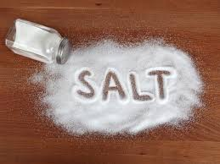
iMHFs
$$f_{G,H}$$
pwd
$$h_{1}$$
$$h_{1}=H(pwd, salt)$$

Slide 13
iMHFs
$$f_{G,H}$$
pwd
$$h_{1}$$
$$h_{2}$$
$$h_{2}=H(h_{1})$$

Slide 14
iMHFs
$$f_{G,H}$$
pwd
$$h_{1}$$
$$h_{2}$$
$$h_{3}$$
$$h_{4}$$
$$h_{3}=H\left(h_{1},h_{2}\right), { h}_{4}=H(h_{2})$$

Slide 15
iMHFs
$$f_{G,H}$$
pwd
$$h_{1}$$
$$h_{2}$$
$$h_{3}$$
$$h_{5}$$
$$h_{4}$$
$$h_{5}=H\left(h_{3},h_{4}\right)$$

Slide 16
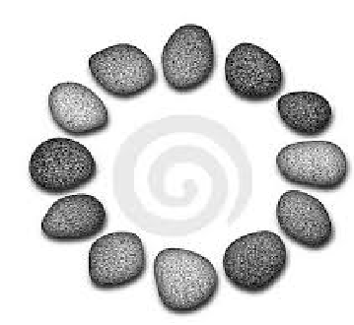
iMHFs
Calculating an iMHF can be modeled as graph pebbling [AS15]

Slide 17
Graph Pebbling

Slide 18
Graph Pebbling

Slide 19
Graph Pebbling

Slide 20
Graph Pebbling

Slide 21
Graph Pebbling

Slide 22
Graph Pebbling

Slide 23
Graph Pebbling

Slide 24
Graph Pebbling

Slide 25
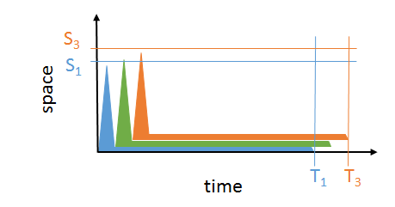
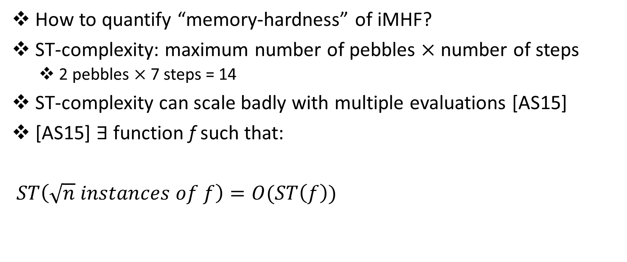
iMHFs
How to quantify “memory-hardness” of iMHF?
ST-complexity: maximum number of pebbles $×$ number of steps
2 pebbles $×$ 7 steps = 14
ST-complexity can scale badly with multiple evaluations [AS15]
[AS15] $∃$function f such that:
$ST\left(\sqrt{n} instances of f\right)=O(ST\left(f\right))$

Slide 26
Graph Pebbling
$$\left|P_{1}\right|=1$$

Slide 27
Graph Pebbling
$$\left|P_{1}\right|+\left|P_{2}\right|=1+2=3$$

Slide 28
Graph Pebbling
$$\left|P_{1}\right|+\left|P_{2}\right|+\left|P_{3}\right|=3+2=5$$

Slide 29
Graph Pebbling
$$\sum_{\left\{i=1\right\}}^{4}{|P_{i}|}=5+1=6$$

Slide 30
Graph Pebbling
$$\sum_{\left\{i=1\right\}}^{5}{|P_{i}|}=6+2=8$$

Slide 31
Graph Pebbling
$$\sum_{\left\{i=1\right\}}^{6}{|P_{i}|}=8+2=10$$

Slide 32
Graph Pebbling
$$cc\left(G\right)=\sum_{\left\{i=1\right\}}^{7}{|P_{i}|}=10+1=11$$

Slide 33




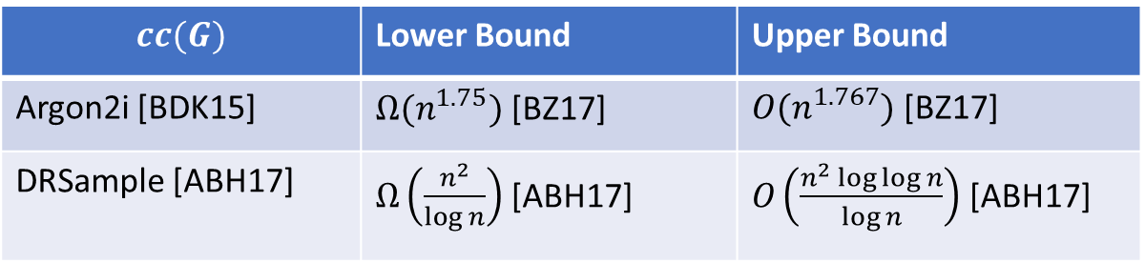
iMHFs
[AS15] CC amortizes well:
$CC\left(n copies of f\right)=n×CC(f)$
$$cc(G)$$ | Lower Bound | Upper Bound
Argon2i [BDK15] | $Ω(n^{1.75})$ [BZ17] | $O(n^{1.767})$ [BZ17]
DRSample [ABH17] | $Ω\left(\frac{n^{2}}{\log{n}}\right)$ [ABH17] | $O\left(\frac{n^{2}\log{\log{n}}}{\log{n}}\right)$ [ABH17]
Gap of $500,000$
$$7.3 ∗{10}^{−6} ∗\frac{n^{2}}{\log{n}}$$
$$\frac{n^{2}}{6}$$

Slide 34
Review
Data-independent memory hard functions require comparatively more resources for adversaries to compute
Calculating an iMHF can be modeled as graph pebbling
Cumulative complexity better model than space-time complexity

Slide 35
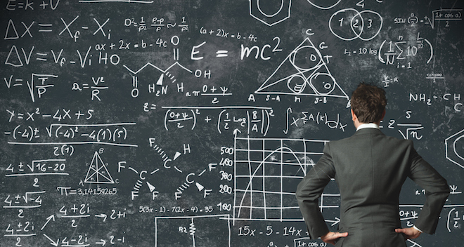

Main Result
Computing $cc(G)$ is NP-hard!
Implication: Cryptanalysis of memory-hard functions is provably hard

Slide 36
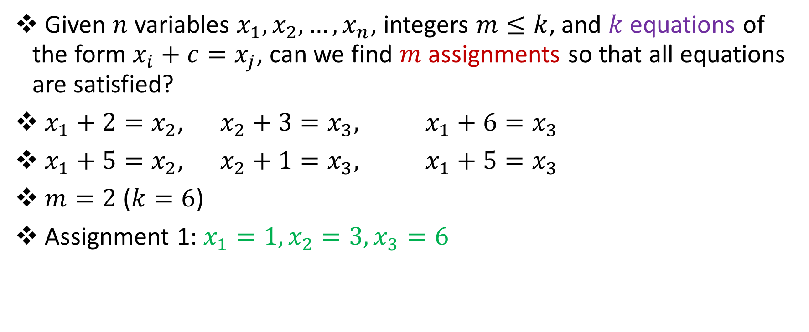
Bounded 2-Linear Covering
Given $n$ variables $x_{1},x_{2},…,x_{n}$, integers $m≤k$, and $k$ equations of the form $x_{i}+c=x_{j}$, can we find $m$ assignments so that all equations are satisfied?
$x_{1}+2=x_{2}$, $x_{2}+3=x_{3},$ $x_{1}+6=x_{3}$
$x_{1}+5=x_{2}$, $x_{2}+1=x_{3},$ $x_{1}+5=x_{3}$
$m=2$ ($k=6$)
Assignment 1: $x_{1}=1,x_{2}=3,x_{3}=6$

Slide 37
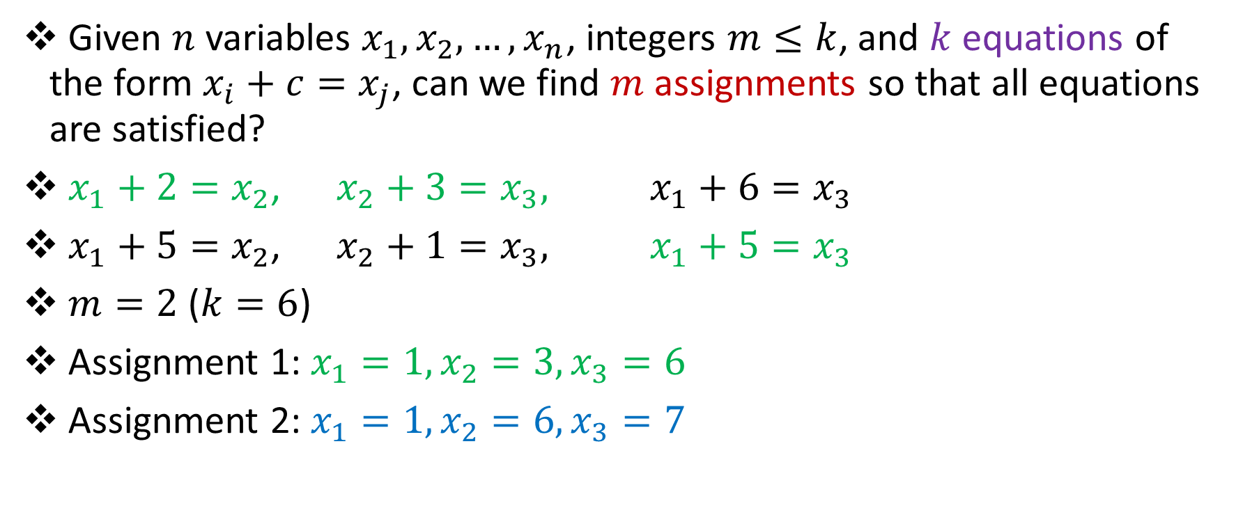
Bounded 2-Linear Covering
Given $n$ variables $x_{1},x_{2},…,x_{n}$, integers $m≤k$, and $k$ equations of the form $x_{i}+c=x_{j}$, can we find $m$ assignments so that all equations are satisfied?
$x_{1}+2=x_{2}$, $x_{2}+3=x_{3},$ $x_{1}+6=x_{3}$
$x_{1}+5=x_{2}$, $x_{2}+1=x_{3},$ $x_{1}+5=x_{3}$
$m=2$ ($k=6$)
Assignment 1: $x_{1}=1,x_{2}=3,x_{3}=6$
Assignment 2: $x_{1}=1,x_{2}=6,x_{3}=7$

Slide 38
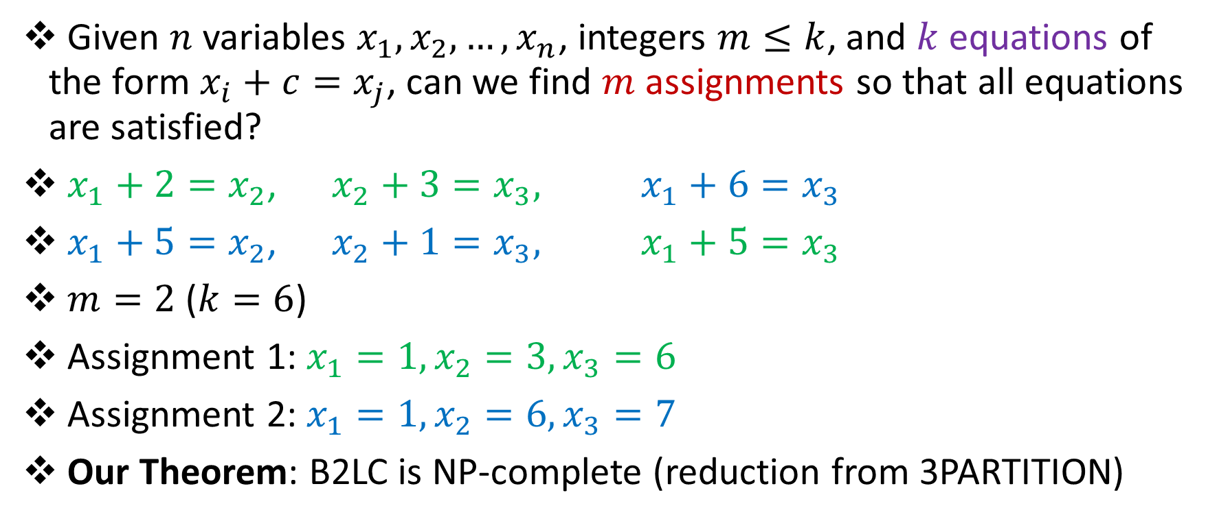
Bounded 2-Linear Covering
Given $n$ variables $x_{1},x_{2},…,x_{n}$, integers $m≤k$, and $k$ equations of the form $x_{i}+c=x_{j}$, can we find $m$ assignments so that all equations are satisfied?
$x_{1}+2=x_{2}$, $x_{2}+3=x_{3},$ $x_{1}+6=x_{3}$
$x_{1}+5=x_{2}$, $x_{2}+1=x_{3},$ $x_{1}+5=x_{3}$
$m=2$ ($k=6$)
Assignment 1: $x_{1}=1,x_{2}=3,x_{3}=6$
Assignment 2: $x_{1}=1,x_{2}=6,x_{3}=7$
Our Theorem: B2LC is NP-complete (reduction from 3PARTITION)

Slide 39



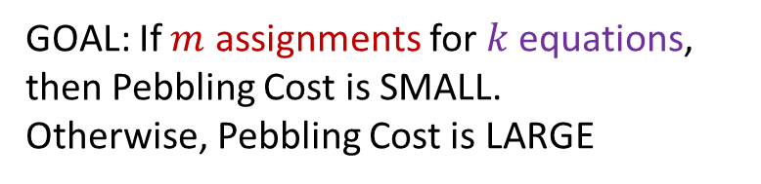
Reductions
GOAL: If $m$ assignments for$k$ equations, then Pebbling Cost is SMALL.
Otherwise, Pebbling Cost is LARGE
$$x_{1}:$$
$$x_{2}:$$

Slide 40


Reductions
GOAL: If $m$ assignments for$k$ equations, then Pebbling Cost is SMALL.
Otherwise, Pebbling Cost is LARGE
$$x_{1}+2=x_{2}:$$
$$x_{1}:$$
$$x_{2}:$$

Slide 41
Honest Pebbling
GOAL: If $m$ assignments for$k$ equations, then Pebbling Cost is SMALL.
Otherwise, Pebbling Cost is LARGE
$$x_{1}+2=x_{2}:$$
$$x_{1}:$$
$$x_{2}:$$

Slide 42
Honest Pebbling
GOAL: If $m$ assignments for$k$ equations, then Pebbling Cost is SMALL.
Otherwise, Pebbling Cost is LARGE
$$x_{1}+2=x_{2}:$$
$$x_{1}:$$
$$x_{2}:$$

Slide 43
Honest Pebbling
GOAL: If $m$ assignments for$k$ equations, then Pebbling Cost is SMALL.
Otherwise, Pebbling Cost is LARGE
$$x_{1}+2=x_{2}:$$
$$x_{1}:$$
$$x_{2}:$$

Slide 44
Honest Pebbling
GOAL: If $m$ assignments for$k$ equations, then Pebbling Cost is SMALL.
Otherwise, Pebbling Cost is LARGE
$$x_{1}+2=x_{2}:$$
$$x_{1}:$$
$$x_{2}:$$

Slide 45
Honest Pebbling
GOAL: If $m$ assignments for$k$ equations, then Pebbling Cost is SMALL.
Otherwise, Pebbling Cost is LARGE
$$x_{1}+2=x_{2}:$$
$$x_{1}:$$
$$x_{2}:$$

Slide 46
Honest Pebbling
GOAL: If $m$ assignments for$k$ equations, then Pebbling Cost is SMALL.
Otherwise, Pebbling Cost is LARGE
$$x_{1}+2=x_{2}:$$
$$x_{1}:$$
$$x_{2}:$$

Slide 47
Honest Pebbling
GOAL: If $m$ assignments for$k$ equations, then Pebbling Cost is SMALL.
Otherwise, Pebbling Cost is LARGE
$$x_{1}+2=x_{2}:$$
$$x_{1}:$$
$$x_{2}:$$

Slide 48
Cheater!
GOAL: If $m$ assignments for$k$ equations, then Pebbling Cost is SMALL.
Otherwise, Pebbling Cost is LARGE
$$x_{1}+2=x_{2}:$$
$$x_{1}:$$
$$x_{2}:$$

Slide 49
Cheater!
GOAL: If $m$ assignments for$k$ equations, then Pebbling Cost is SMALL.
Otherwise, Pebbling Cost is LARGE
$$x_{1}+2=x_{2}:$$
$$x_{1}:$$
$$x_{2}:$$

Slide 50
Cheater!
GOAL: If $m$ assignments for$k$ equations, then Pebbling Cost is SMALL.
Otherwise, Pebbling Cost is LARGE
$$x_{1}+2=x_{2}:$$
$$x_{1}:$$
$$x_{2}:$$

Slide 51
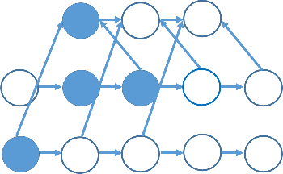
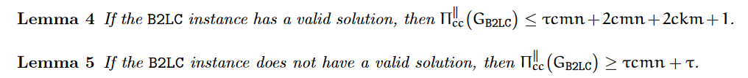
Cheater!

Slide 52
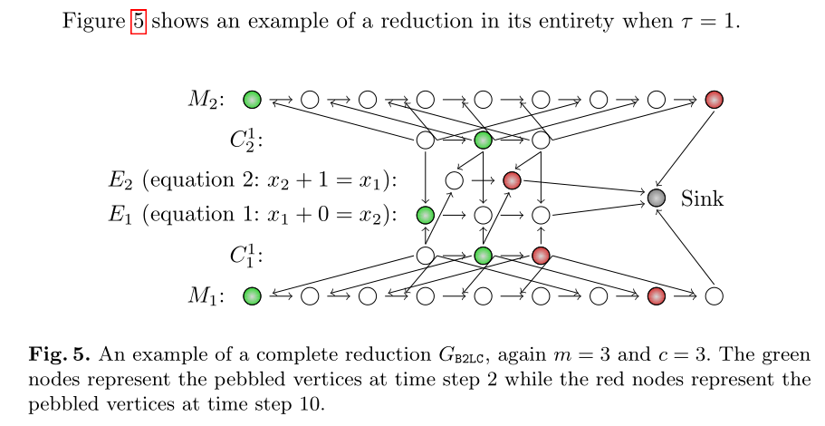
Reductions

Slide 53
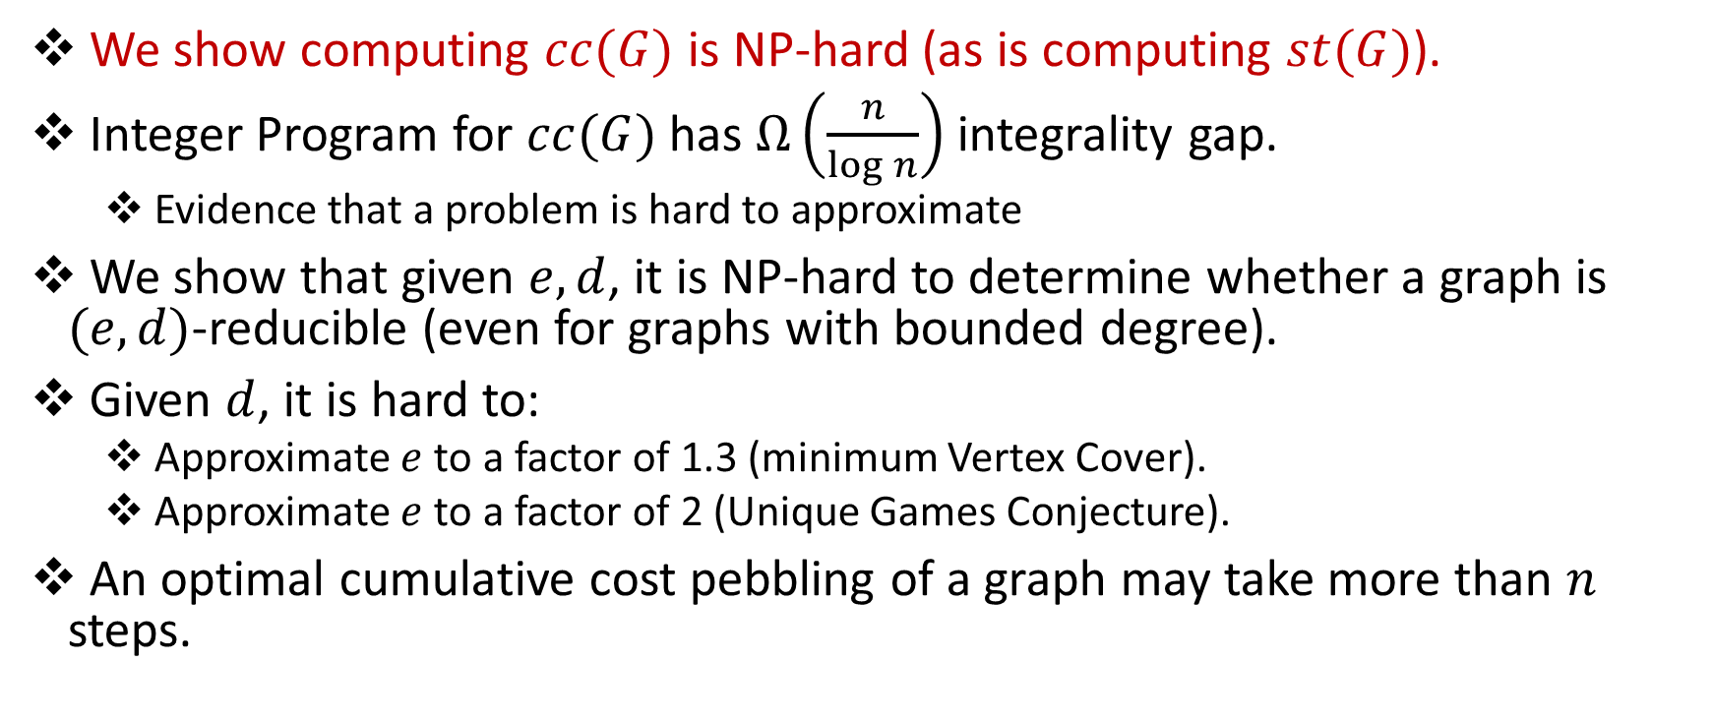
Summary
We show computing $cc(G)$ is NP-hard (as is computing $st(G)$).
Integer Program for $cc(G)$ has $Ω\left(\frac{n}{\log{n}}\right)$ integrality gap.
Evidence that a problem is hard to approximate
We show that given $e,d$, it is NP-hard to determine whether a graph is $(e,d)$-reducible (even for graphs with bounded degree).
Given $d$, it is hard to:
Approximate $e$ to a factor of 1.3 (minimum Vertex Cover).
Approximate $e$ to a factor of 2 (Unique Games Conjecture).
An optimal cumulative cost pebbling of a graph may take more than $n$ steps.

Slide 54
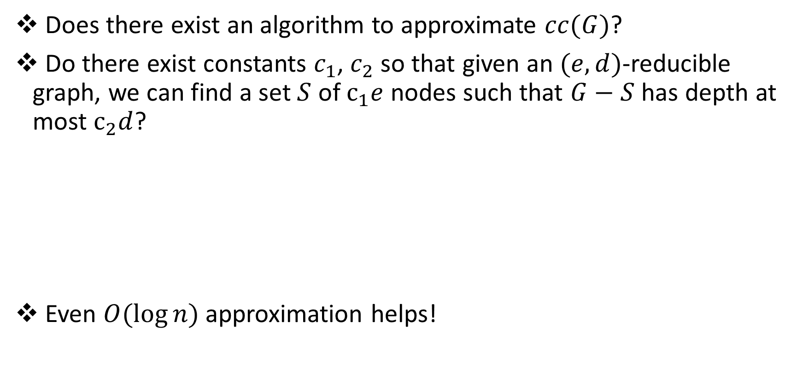
Open Questions
Does there exist an algorithm to approximate $cc(G)$?
Do there exist constants $c_{1}$, $c_{2}$ so that given an $(e,d)$-reducible graph, we can find a set $S$ of $c_{1}e$ nodes such that $G−S$ has depth at most $c_{2}d$?
Even $O(\log{n)}$ approximation helps!
1
2
3
4
5
6
7
$(1,3)$ - reducible

Slide 55
Graph Reducibility
We say that a directed acyclic graph $G$ is $(e,d)$-reducible if there exists a set $S$ of $e$ nodes such that $G−S$ has depth at most $d$.
1
2
3
4
5
6
7
$(1,3)$ - reducible

Slide 56
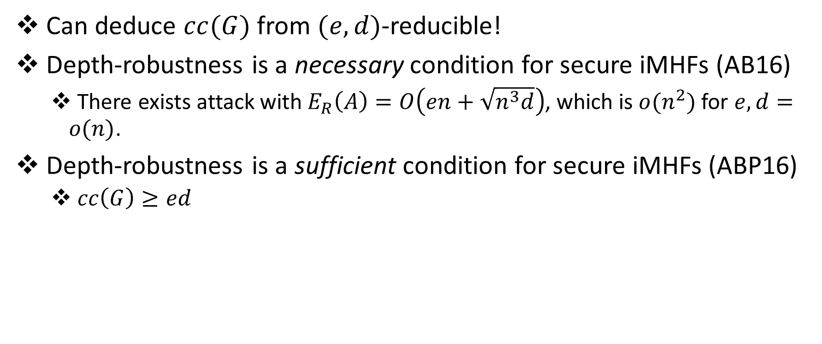
Graph Reducibility
Can deduce $cc(G)$ from $(e,d)$-reducible!
Depth-robustness is a necessary condition for secure iMHFs (AB16)
There exists attack with $E_{R}\left(A\right)=O\left(en+\sqrt{n^{3}d}\right)$, which is $o(n^{2})$ for $e,d=o(n)$.
Depth-robustness is a sufficient condition for secure iMHFs (ABP16)
$cc\left(G\right)≥ed$

Slide 57


Slide 58
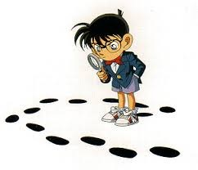
Questions?

Slide 59
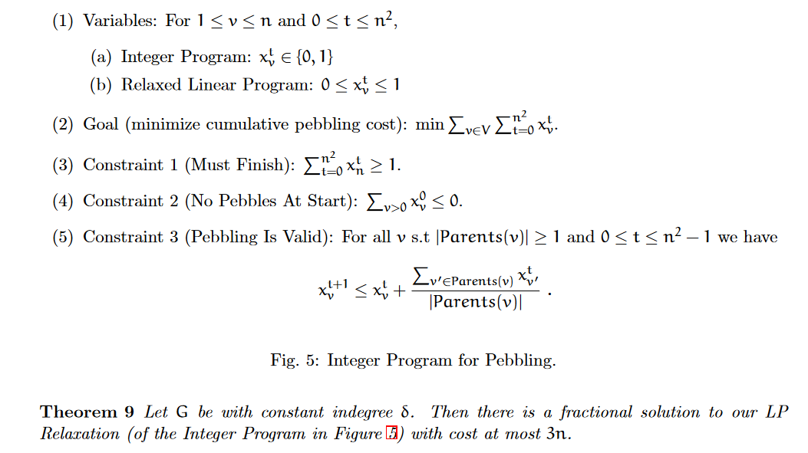


Slide 60
Reductions
Reducing 3-PARTITION to B2LC
Reducing B2LC to $cc(G)$

Slide 61
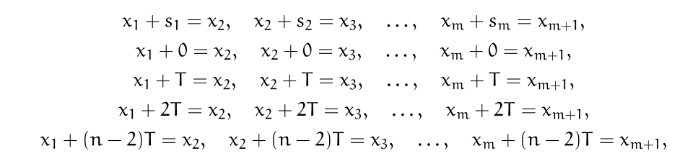

Reductions
$$T=\sum_{\left\{i=1\right\}}^{m}{s_{m}}$$

Slide 62
Reductions
$$m$$
$$n$$
$m=3n$ integers in original 3-PARTITION instance

Slide 63
Reductions
$$m$$
$$n$$
$m=3n$ integers in original 3-PARTITION instance

Slide 64
Reductions
$$m$$
$$n$$
$m=3n$ integers in original 3-PARTITION instance

Slide 65
Reductions
$$m$$
$$n$$
$m=3n$ integers in original 3-PARTITION instance

Slide 66
Reductions
$$m$$
$$n$$
$m=3n$ integers in original 3-PARTITION instance

Slide 67
3-PARTITION
Given set of $3n$ integers, can we partition them into $n$ sets, each with the same sum?
$\left\{1,2,4,5,6,7,8,11,13\right\}$
$\left\{2,4,13\right\}→19$ $\left\{1,7,11\right\}→19$ $\left\{5,6,8\right\}→19$
$\{1,2,3,4,6,7,9,10,11\}$

Slide 68
Reductions
Reducing 3-PARTITION to B2LC
Reducing B2LC to $cc(G)$

